Slide 1

Wavefront propagation for X-ray beamlines with SRW
Rafael Celestre
rafael.celestre@synchrotron-soleil.fr
Groupe Optique, Division Expériences, Synchrotron SOLEIL

Slide 2
Wavefront propagation for X-ray beamlines with SRW
Outline:
Prologue
Brief introduction to scalar wave optics
Free-space propagation with SRW
Thin optical elements
Thick optical elements
Where to learn more?

Slide 3







“Synchrotron Radiation Workshop” (electrodynamics simulation code for SR emission and propagation)
First official version of SRW was developed at ESRF in 1997-98 (written in C++, interfaced to IGOR Pro); Oleg Chubar and Pascal Elleaume "Accurate and efficient computation of synchrotron radiation in the near field region", Proc. EPAC-98, 1177-1179 (1998).
SRW was released to open source in 2012 under BSD type license.
The main open-source repository, containing all C/C++ sources, C API, all interfaces and project development files, is on GitHub:
https://github.com/ochubar/SRW

Slide 4
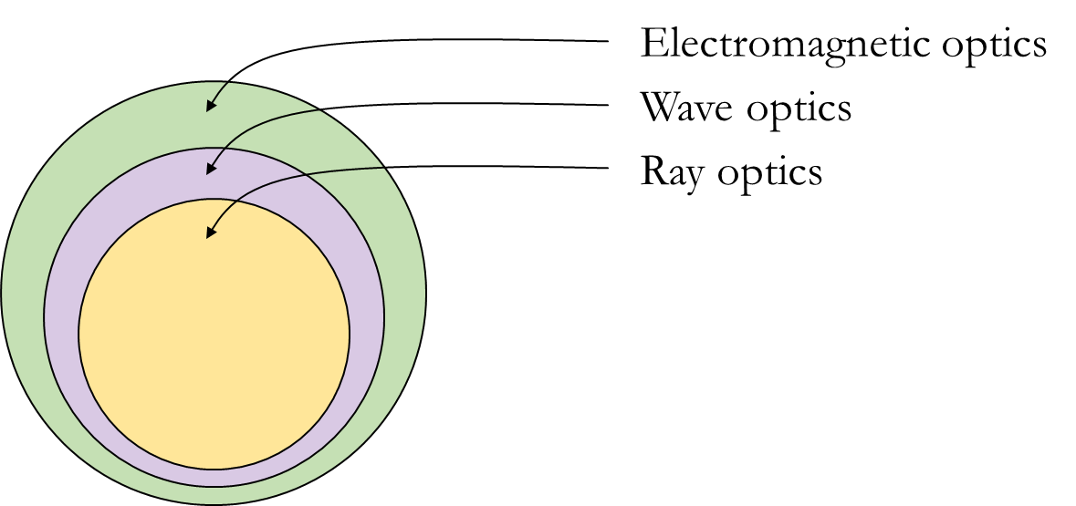
Prologue
Choosing an adequate optical theory for simulations:
“As simple as possible, as accurate as necessary.”
We use physical optics when diffraction effects cannot be neglected:
IR, UV and soft x-ray beamlines in current and low-emittance light sources;
whenever spatial filtering causes the increase in the coherent fraction (CF):
“increasing the propagation distance” – cf. van Cittert-Zenike theorem
“closing the aperture to match the coherence length”
“slitting down the secondary source”…
(a) hierarchical optical theories

Slide 5
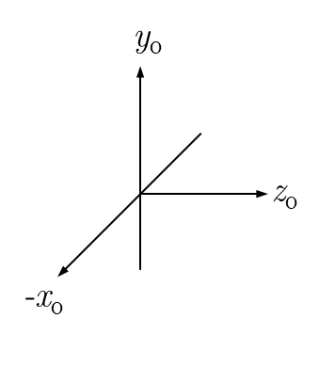
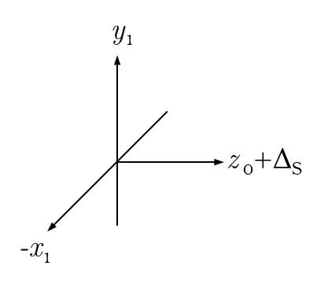
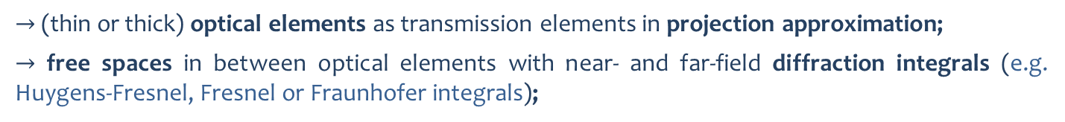
Prologue
Wave-optical simulations deal with two classes of beamline elements:
oe
n
oe
n+1
free space
(a) generic beamline
$→$ (thin or thick) optical elements as transmission elements in projection approximation;
$→$ free spaces in between optical elements with near- and far-field diffraction integrals (e.g. Huygens-Fresnel, Fresnel or Fraunhofer integrals);

Slide 6
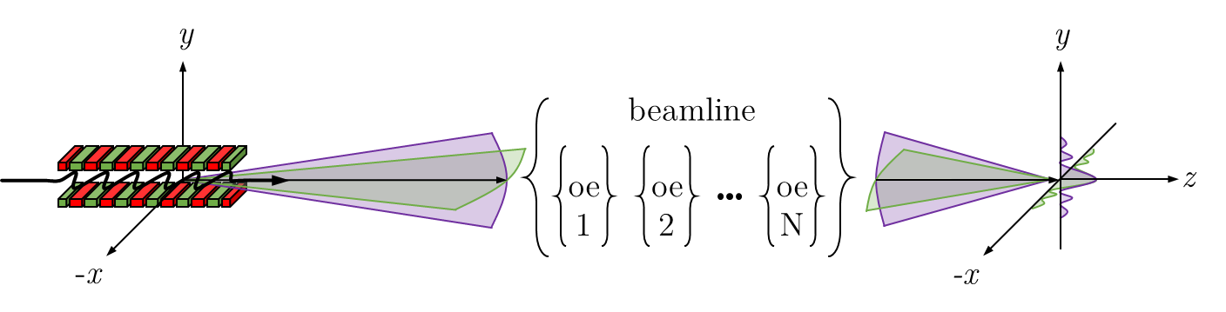
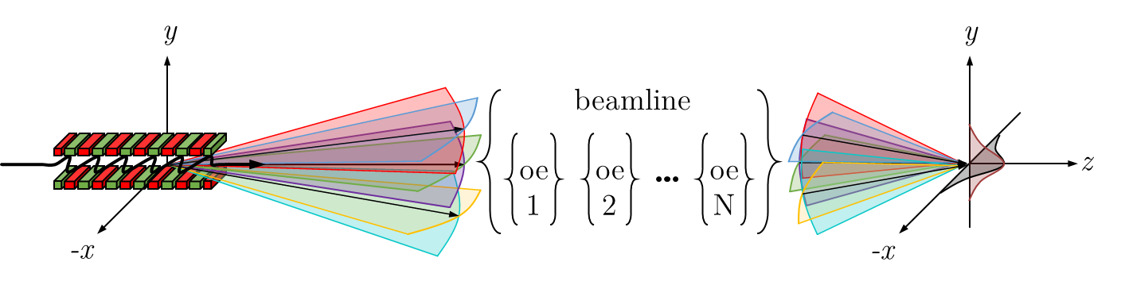
Prologue
Fully-coherent simulations (point source):
(a) fully-coherent simulation (filament beam, zero emittance, single electron…)
Partially-coherent simulations (extended source):
(b) partially-coherent simulation (thick beam, finite emittance, multi-electron…)

Slide 7
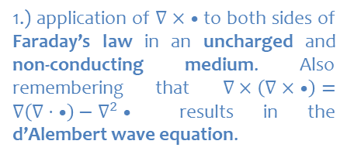
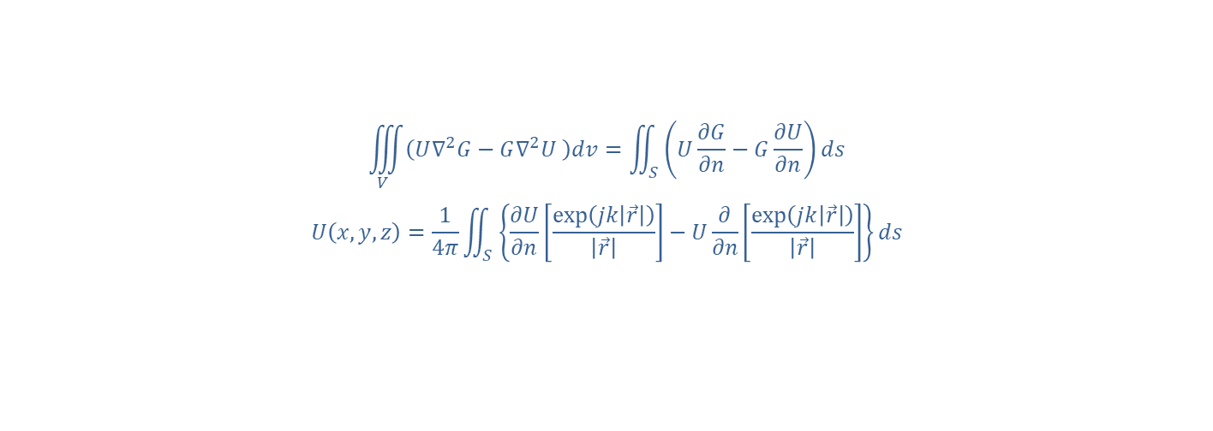
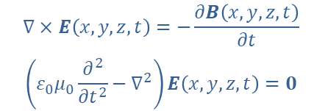
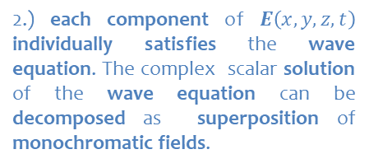
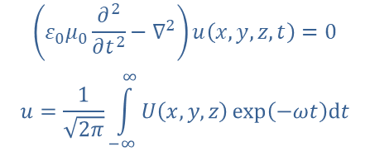
Scalar wave theory – how did we get here?
$$∇×E\left(x,y,z,t\right)=−\frac{∂B\left(x,y,z,t\right)}{∂t}$$
$$\left(ε_{0}μ_{0}\frac{∂^{2}}{∂t^{2}}−∇^{2}\right)E\left(x,y,z,t\right)=0$$
$$\left(ε_{0}μ_{0}\frac{∂^{2}}{∂t^{2}}−∇^{2}\right)u\left(x,y,z,t\right)=0$$
$$u=\frac{1}{\sqrt{2π}}\int_{−∞}^{∞}{U\left(x,y,z\right)\exp\left(−ωt\right)dt}$$
$$\left(∇^{2}+k\right)U\left(x,y,z\right)=0$$
1.) application of $∇× •$ to both sides of Faraday’s law in an uncharged and non-conducting medium. Also remembering that $∇×\left(∇× •\right)=∇\left(∇⋅ •\right)−∇^{2}•$ results in the d’Alembert wave equation.
2.) each component of $E\left(x,y,z,t\right)$ individually satisfies the wave equation. The complex scalar solution of the wave equation can be decomposed as superposition of monochromatic fields.
3.) this is the Helmholtz equation. Given a volume in space and boundary conditions, the scalar diffraction theory consists in finding solution to the Helmholtz equation.
$$\iiint_{V}^{ }{\left(U∇^{2}G−G∇^{2}U \right)dv}=\iint_{S}^{ }{\left(U\frac{∂G}{∂n}−G\frac{∂U}{∂n}\right)ds}$$
$$U\left(x,y,z\right)=\frac{1}{4π}\iint_{S}^{ }{\left\{\frac{∂U}{∂n}\left[\frac{\exp\left(jk\left|\vec{r}\right|\right)}{\left|\vec{r}\right|}\right]−U\frac{∂}{∂n}\left[\frac{\exp\left(jk\left|\vec{r}\right|\right)}{\left|\vec{r}\right|}\right]\right\}ds}$$
4.) Calculation of $U\left(x,y,z\right)$ at an observation point in space can be done using Green’s theorem. An arbitrary and careful choice of the Green’s function $G$ results in the integral theorem of Helmholtz and Kirchhoff. Yet another careful choice of Green’s function and boundary conditions yield in the Rayleigh-Sommerfeld formulation of diffraction.
Paganin, Coherent X-Ray Optics, (2006)
Goodman, Introduction to Fourier Optics, (2017)

Slide 8
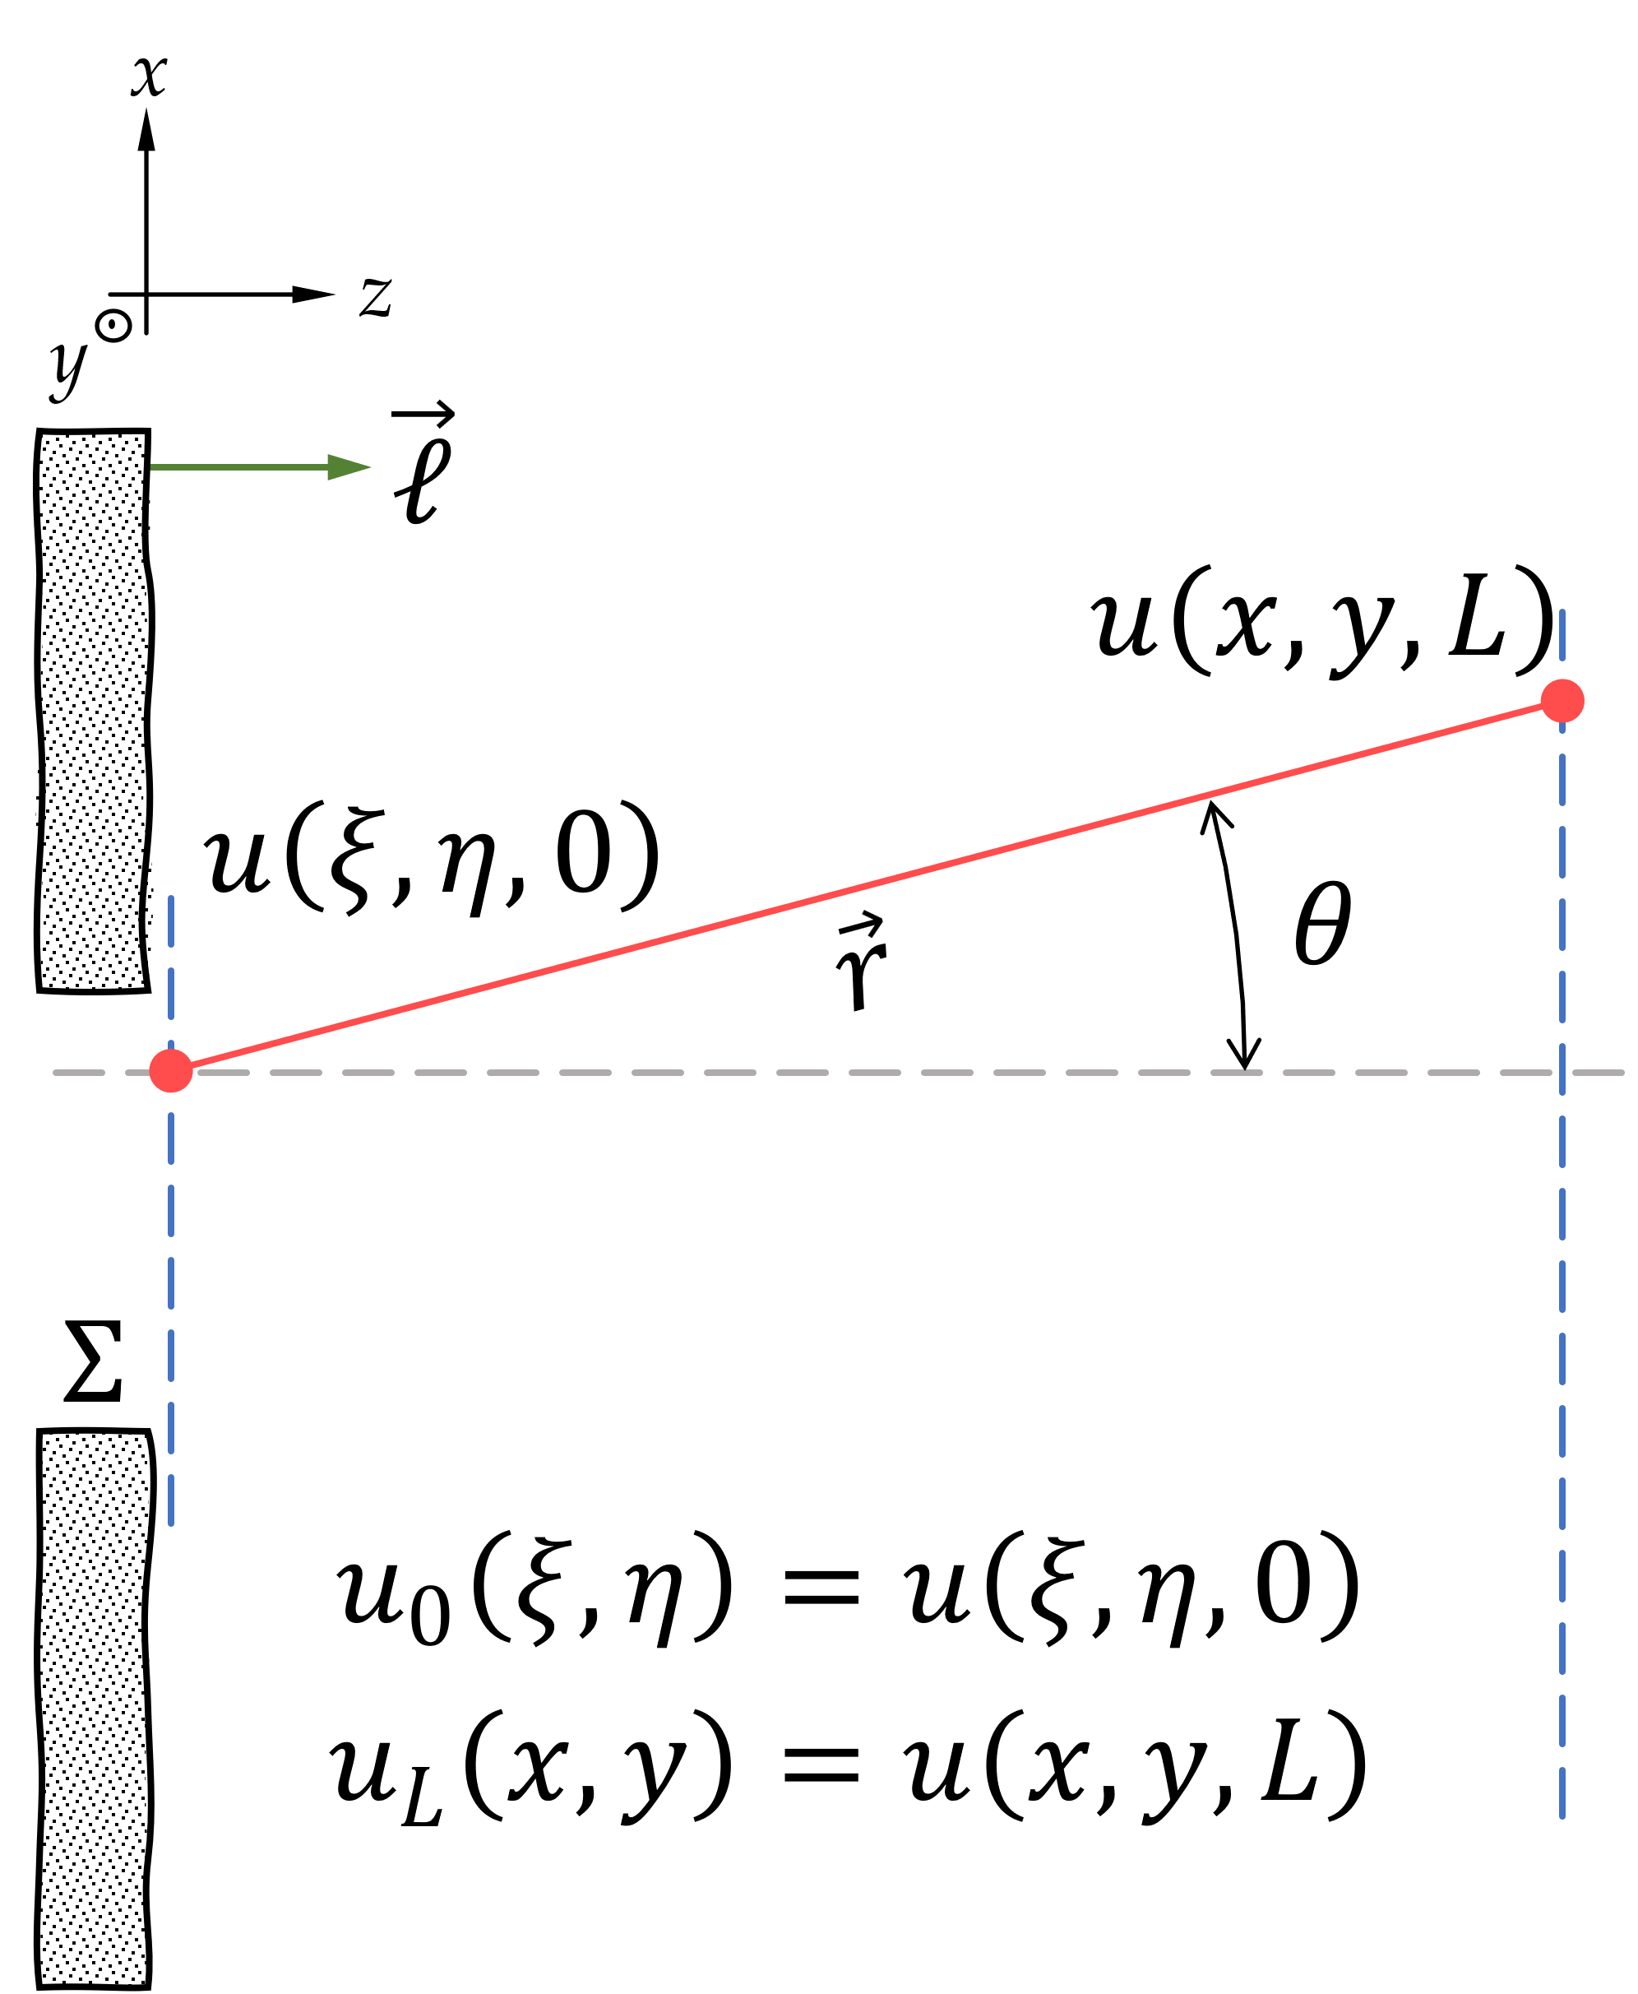

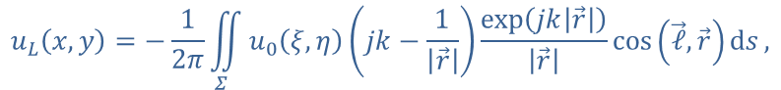
Scalar wave theory – Rayleigh-Sommerfeld formulation
If $U\left({\vec{r}}_{0}\right)$ vanishes in the shadow of the screen and is undisturbed in $Σ$ (aperture):
$$u_{L}\left(x,y\right)=−\frac{1}{2π}\iint_{Σ}^{ }{u_{0}\left(ξ,η\right)\left(jk−\frac{1}{\left|\vec{r}\right|}\right)}\frac{exp\left(jk\left|\vec{r}\right|\right)}{\left|\vec{r}\right|}\cos\left(\vec{ℓ},\vec{r}\right)ds,$$
with $\left|\vec{r}\right|=\sqrt{L^{2}+{\left(x−ξ\right)}^{2}+{\left(y−η\right)}^{2}}$, $cos \left(\vec{ℓ},\vec{r}\right)=L/\left|\vec{r}\right|$ and $ds=dξdη$.
The above equation is a convolution between the input field and a kernel:
$$\begin{matrix}u_{0}\left(x,y\right)∗h\left(x,y\right) & = & \iint_{−∞}^{∞}{u_{0}\left(ξ,η\right)⋅h\left(x−ξ,y−η\right)dξdη} \\ & = & ℱ^{−1}\left\{ℱ\left\{u_{0}\left(x,y\right)\right\}⋅ℱ\left\{h\left(x,y\right)\right\}\right\}\end{matrix}$$
The kernel of the RS diffraction integral is given by:
(a) formulation of diffraction by a plane-screen
$$h_{RS}\left(x,y\right)=h_{1}+h_{2}=\frac{L}{jλ}\frac{\exp\left( jk\left|\vec{r}\right|\right)}{{\left|\vec{r}\right|}^{2}}+\frac{L}{2π}\frac{\exp\left( jk\left|\vec{r}\right|\right)}{{\left|\vec{r}\right|}^{3}}$$
For most cases of interest $r≫λ$ and hence, $h$ can be approximated by $h_{1}$.
Goodman, Introduction to Fourier Optics, (2017)

Slide 9
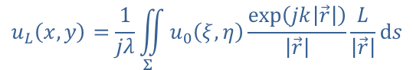

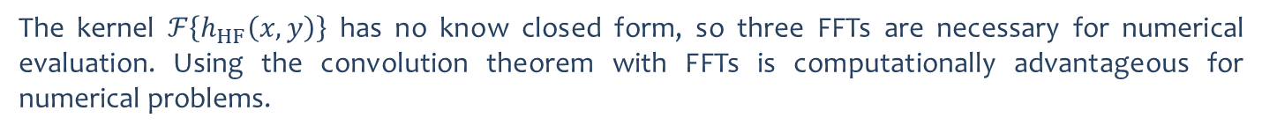
Scalar wave theory – Huygens-Fresnel formulation
SRW propagator #5
Applying $r≫λ$ to the first Rayleigh-Sommerfeld solution:
$$u_{L}\left(x,y\right)=\frac{1}{jλ}\iint_{Σ}^{ }{u_{0}\left(ξ,η\right)}\frac{exp\left(jk\left|\vec{r}\right|\right)}{\left|\vec{r}\right|}\frac{L}{\left|\vec{r}\right|}ds$$
Which is a convolution with kernel given by:
$$h_{HF}\left(x,y\right)=\frac{L}{jλ}\frac{\exp\left( jk\left|\vec{r}\right|\right)}{{\left|\vec{r}\right|}^{2}}$$
The propagated wave can be calculated as:
$${u_{L}\left(x,y\right)=ℱ}^{−1}\left\{ℱ\left\{u_{0}\left(x,y\right)\right\}⋅ℱ\left\{h_{HF}\left(x,y\right)\right\}\right\}$$
The kernel $ℱ\left\{h_{HF}\left(x,y\right)\right\}$ has no know closed form, so three FFTs are necessary for numerical evaluation. Using the convolution theorem with FFTs is computationally advantageous for numerical problems.
Goodman, Introduction to Fourier Optics, (2017)

Slide 10
Scalar wave theory – Huygens-Fresnel formulation
SRW propagator #5
$${u_{L}\left(x,y\right)=ℱ}^{−1}\left\{ℱ\left\{u_{0}\left(x,y\right)\right\}⋅ℱ\left\{h_{HF}\left(x,y\right)\right\}\right\}$$
“the split propagator/Huygens-Fresnel diffraction integral”
Short description: the Huygens-Fresnel diffraction integral is implemented by using the convolution theorem with 3x FFT.
General use:
strong (de)magnification systems (e.g. nano KB, FZP…) where the paraxial approximation is less recommended;
Comments:
preserves number of pixel and ranges of the input plane;
works for strongly astigmatic systems;
recently implemented and not extensive used as the other propagators.
He et al, Proc. SPIE 12697(03) (2023)

Slide 11
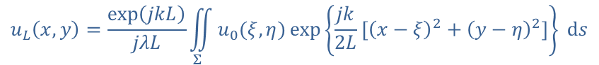
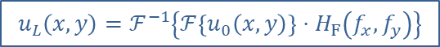
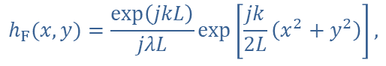
Scalar wave theory – the Fresnel diffraction
SRW propagator #0
The paraxial approximation of the Huygens-Fresnel integral can be obtained by using the binomial expansion to the square root in $\left|\vec{r}\right|$ provided that $L^{2}≫{\left(x−ξ\right)}^{2}$, $L^{2}≫{\left(y−η\right)}^{2}$:
$$u_{L}\left(x,y\right)=\frac{exp\left(jkL\right)}{jλL}\iint_{Σ}^{ }{u_{0}(ξ,η)}\exp\left\{\frac{jk}{2L}\left[{\left(x−ξ\right)}^{2}+{\left(y−η\right)}^{2}\right]\right\} ds$$
The diffraction integral above is a convolution between the input field $u_{0}$ and a kernel $h_{F}$:
$$h_{F}(x, y)=\frac{exp\left(jkL\right)}{jλL}\exp\left[\frac{jk}{2L}\left(x^{2}+y^{2}\right)\right],$$
which has analytical Fourier transform $H_{F}\left(f_{x}, f_{y}\right)=exp\left(jkL\right)\exp\left[−jπλL\left(f_{x}^{2}+f_{y}^{2}\right)\right]$. Hence, the calculation of the Fresnel diffraction integral is done using two FFT operations
$${u_{L}\left(x,y\right)=ℱ}^{−1}\left\{ℱ\left\{u_{0}\left(x,y\right)\right\}⋅H_{F}\left(f_{x},f_{y}\right)\right\}$$
Goodman, Introduction to Fourier Optics, (2017)

Slide 12
Scalar wave theory – the Fresnel diffraction
SRW propagator #0
$${u_{L}\left(x,y\right)=exp\left(jkL\right)⋅ℱ}^{−1}\left\{ℱ\left\{u_{0}\left(x,y\right)\right\}⋅\exp\left[−jπλL\left(f_{x}^{2}+f_{y}^{2}\right)\right]\right\}$$
“Standard Fresnel”
Short description: the standard Fresnel diffraction integral is implemented by using the convolution theorem with 2x FFT.
General use:
propagation over free-space with gentle (de)magnification;
to be used before slits, ideal lenses and smooth phase elements;
Comments:
preserves number of pixel and ranges of the input plane;
works for strongly astigmatic systems;

Slide 13
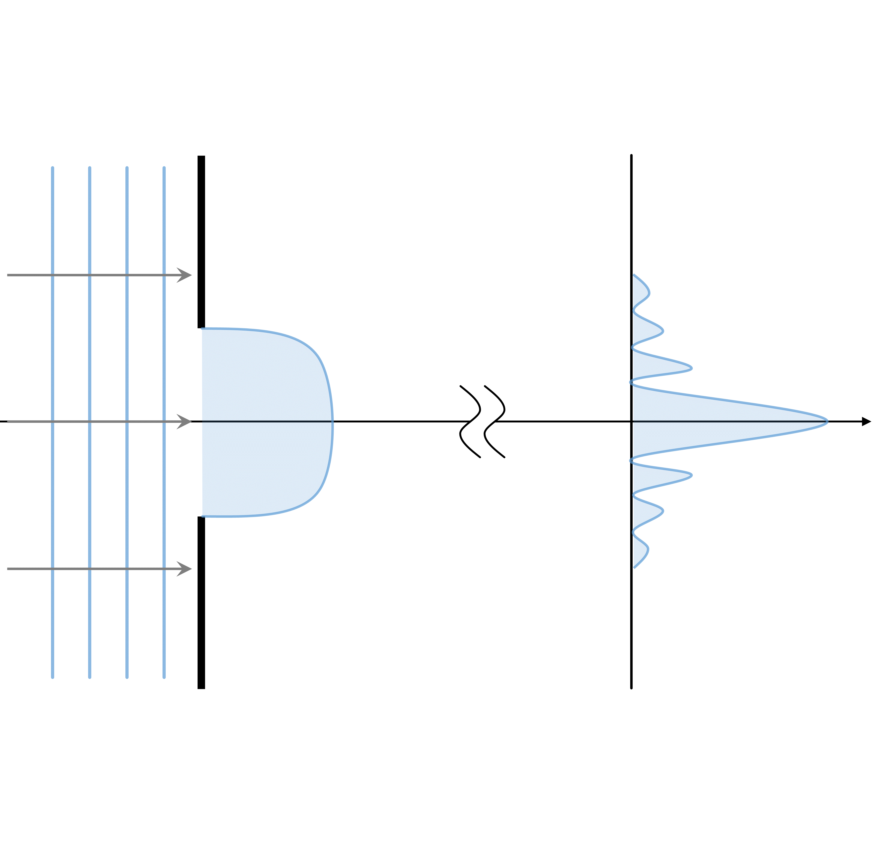
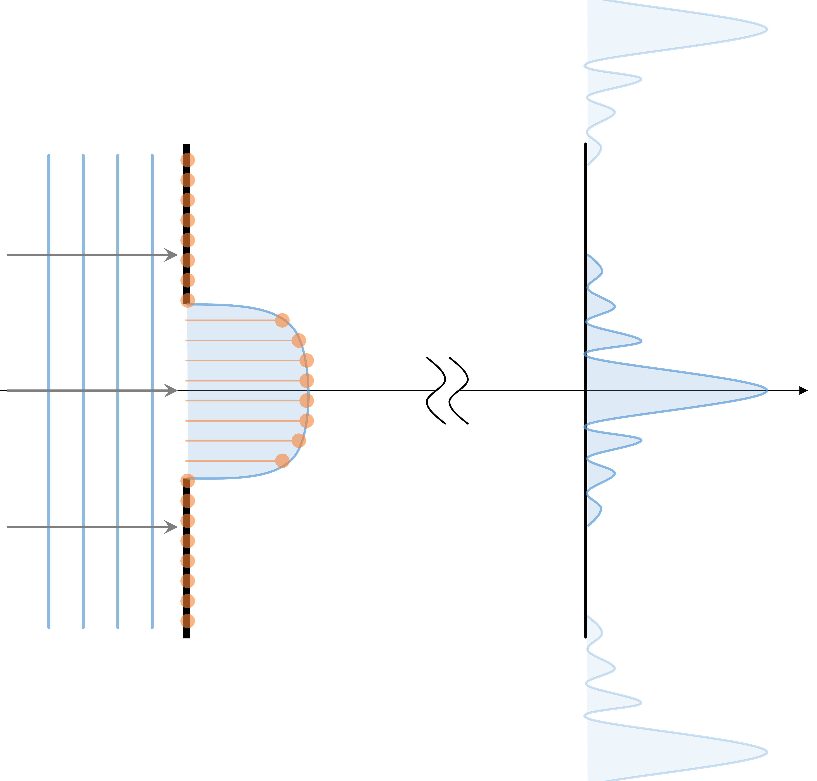
Scalar wave theory – the Fresnel diffraction
Issues: when calculating numerically the convolution-type or the Fourier transformation-type integrals replicas and aliasing occur.
(a) analytical solution
(b) numerical calculation with sampling artifacts (replicas)
Kelly, J. Opt. Soc. Am. A 31(4), 755 (2014)

Slide 14
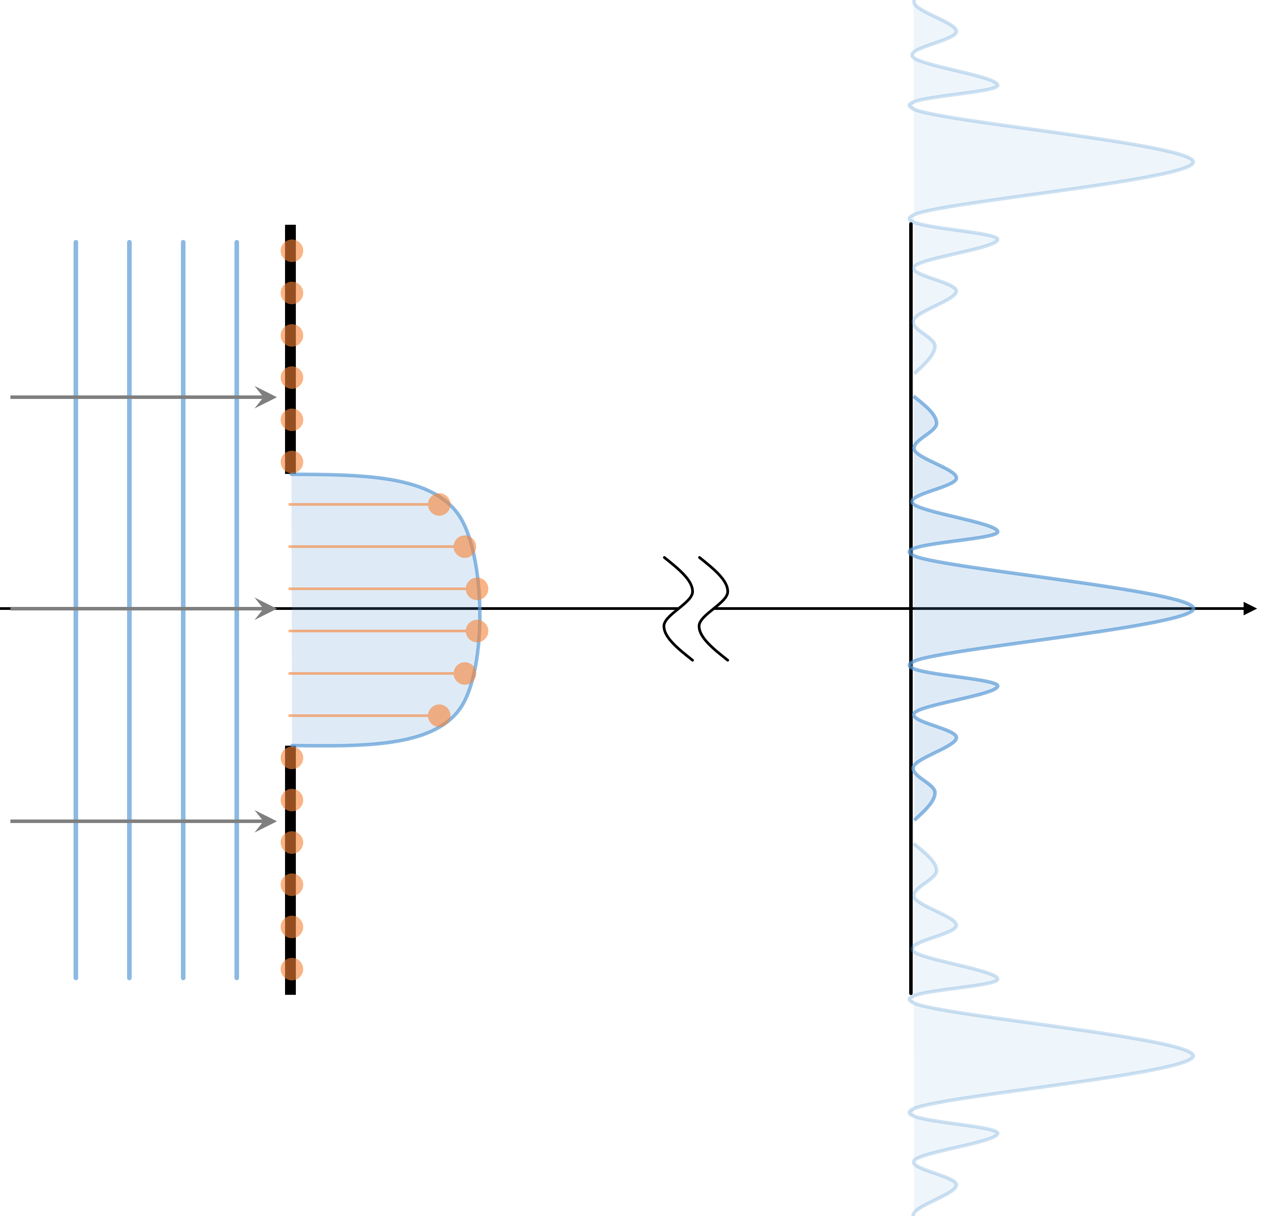
Scalar wave theory – the Fresnel diffraction
Issues: when calculating numerically the convolution-type or the Fourier transformation-type integrals replicas and aliasing occur.
(a) analytical solution
(b) numerical calculation with sampling artifacts (replicas)
Kelly, J. Opt. Soc. Am. A 31(4), 755 (2014)

Slide 15
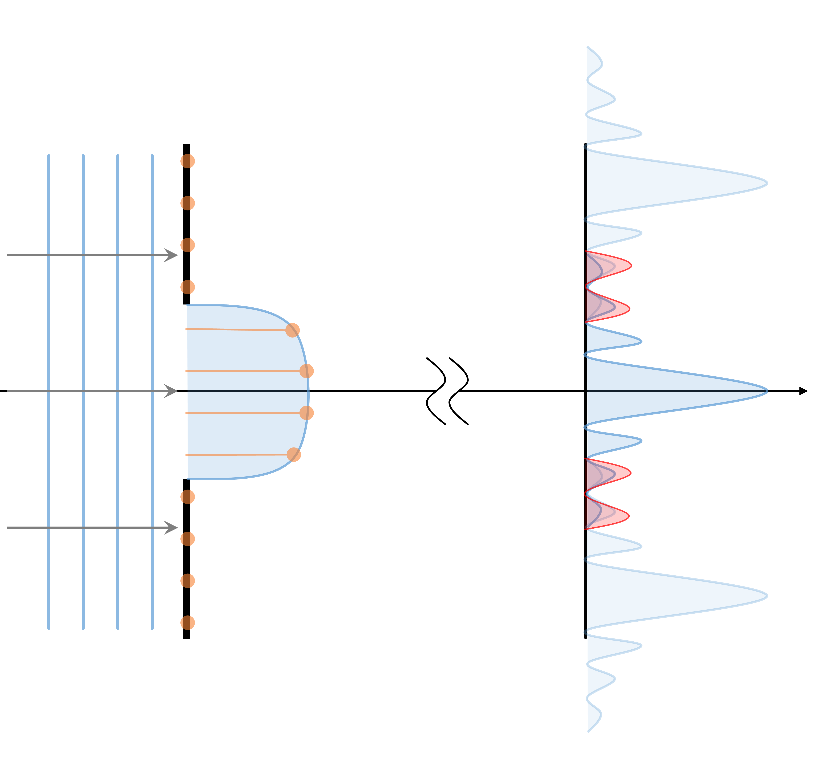
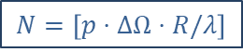
Scalar wave theory – the Fresnel diffraction
Issues: when calculating numerically the convolution-type or the Fourier transformation-type integrals replicas and aliasing occur.
$$N=\left[p⋅ΔΩ⋅R/λ\right]$$
(a) analytical solution
(b) numerical calculation with sampling artifacts (replicas)
Kelly, J. Opt. Soc. Am. A 31(4), 755 (2014)

Slide 16
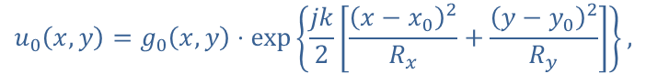
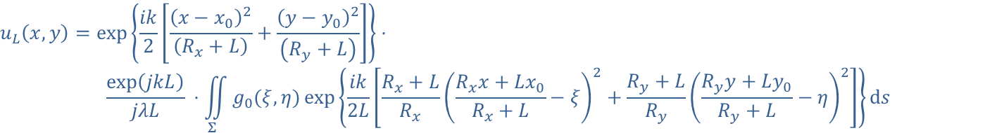
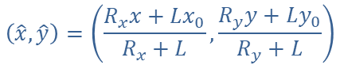
Scalar wave theory – the Fresnel diffraction
SRW propagator #1
Assuming the input field has a quadratic phase term defined by the wavefront curvature $(R_{x}, R_{y})$ centred at $(x_{0},y_{0})$:
$$u_{0}\left(x,y\right)=g_{0}\left(x,y\right)⋅\exp\left\{\frac{jk}{2}\left[\frac{{\left(x−x_{0}\right)}^{2}}{R_{x}}+\frac{{\left(y−y_{0}\right)}^{2}}{R_{y}}\right]\right\},$$
The Fresnel diffraction integral can be re-written as:
$$u_{L}\left(x,y\right)=\exp\left\{\frac{ik}{2}\left[\frac{{\left(x−x_{0}\right)}^{2}}{\left(R_{x}+L\right)}+\frac{{\left(y−y_{0}\right)}^{2}}{\left(R_{y}+L\right)}\right]\right\}⋅$$
$$\frac{exp\left(jkL\right)}{jλL} ⋅\iint_{Σ}^{ }{g_{0}(ξ,η)}exp\left\{\frac{ik}{2L}\left[\frac{R_{x}+L}{R_{x}}{\left(\frac{R_{x}x+Lx_{0}}{R_{x}+L}−ξ\right)}^{2}+\frac{R_{y}+L}{R_{y}}{\left(\frac{R_{y}y+Ly_{0}}{R_{y}+L}−η\right)}^{2}\right]\right\}ds$$
Which is a convolution integral with the reduced coordinates:
$$\left(\hat{x},\hat{y}\right)=\left(\frac{R_{x}x+Lx_{0}}{R_{x}+L},\frac{R_{y}y+Ly_{0}}{R_{y}+L}\right)$$
Chubar and Celestre, Opt. Express 27(20), 28750 (2019)

Slide 17
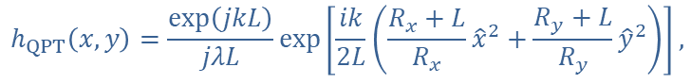
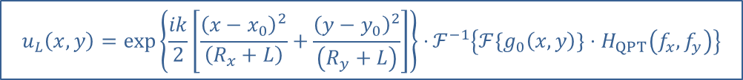
Scalar wave theory – the Fresnel diffraction
SRW propagator #1
The kernel of the transformation as a function of the reduced coordinates is given by:
$$h_{QPT}\left(x,y\right)=\frac{exp\left(jkL\right)}{jλL}exp\left[\frac{ik}{2L}\left(\frac{R_{x}+L}{R_{x}}{\hat{x}}^{2}+\frac{R_{y}+L}{R_{y}}{\hat{y}}^{2}\right)\right],$$
with analytical Fourier transform $H_{QPT}\left(f_{x}, f_{y}\right)$:
$$H_{QPT}\left(f_{x}, f_{y}\right)=exp\left(jkL\right)⋅\sqrt{\frac{R_{x}R_{y}}{\left(R_{x}+L\right)\left(R_{y}+L\right)}}⋅\exp\left[−jπLλ\left(\frac{R_{x}}{R_{x}+L}f_{x}^{2}+\frac{R_{y}}{R_{y}+L}f_{y}^{2}\right)\right]$$
The calculation of the Fresnel transform with the analytical treatment of the quadratic phase term:
$${u_{L}\left(x,y\right)=\exp\left\{\frac{ik}{2}\left[\frac{{\left(x−x_{0}\right)}^{2}}{\left(R_{x}+L\right)}+\frac{{\left(y−y_{0}\right)}^{2}}{\left(R_{y}+L\right)}\right]\right\}⋅ℱ}^{−1}\left\{ℱ\left\{g_{0}\left(x,y\right)\right\}⋅H_{QPT}\left(f_{x}, f_{y}\right)\right\}$$
Chubar and Celestre, Opt. Express 27(20), 28750 (2019)

Slide 18
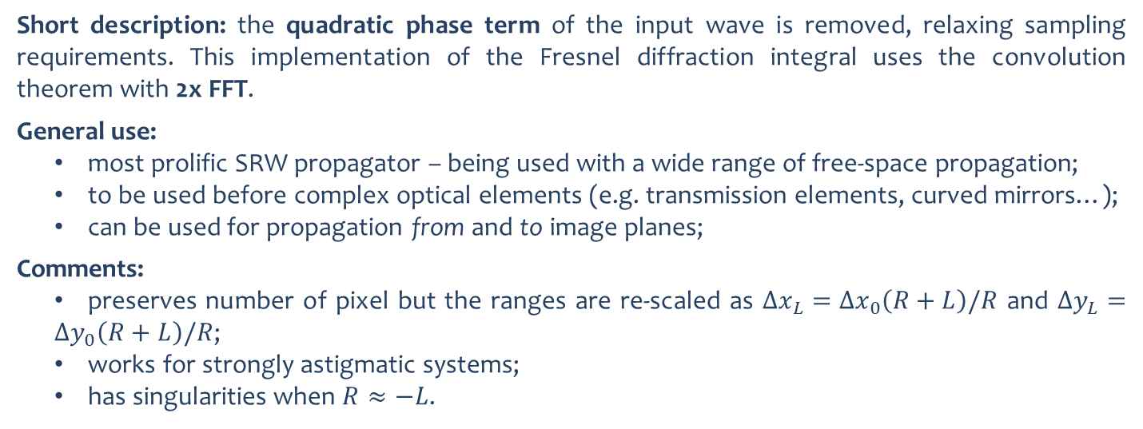
Scalar wave theory – the Fresnel diffraction
SRW propagator #1
$${u_{L}\left(x,y\right)=\exp\left\{\frac{ik}{2}\left[\frac{{\left(x−x_{0}\right)}^{2}}{\left(R+L\right)}+\frac{{\left(y−y_{0}\right)}^{2}}{\left(R+L\right)}\right]\right\}⋅ℱ}^{−1}\left\{ℱ\left\{g_{0}\left(x,y\right)\right\}⋅H_{QPT}\left(f_{x}, f_{y}\right)\right\}$$
“Fresnel with analytical treatment of the quadratic (leading) phase terms”
Short description: the quadratic phase term of the input wave is removed, relaxing sampling requirements. This implementation of the Fresnel diffraction integral uses the convolution theorem with 2x FFT.
General use:
most prolific SRW propagator – being used with a wide range of free-space propagation;
to be used before complex optical elements (e.g. transmission elements, curved mirrors…);
can be used for propagation from and to image planes;
Comments:
preserves number of pixel but the ranges are re-scaled as $Δx_{L}=Δx_{0}\left(R+L\right)/R$ and $Δy_{L}=Δy_{0}\left(R+L\right)/R$;
works for strongly astigmatic systems;
has singularities when $R≈−L$.
Chubar and Celestre, Opt. Express 27(20), 28750 (2019)

Slide 19
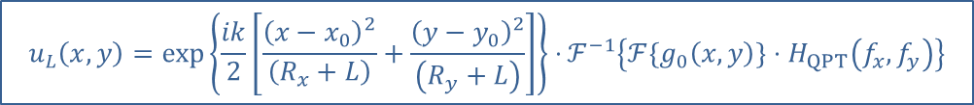
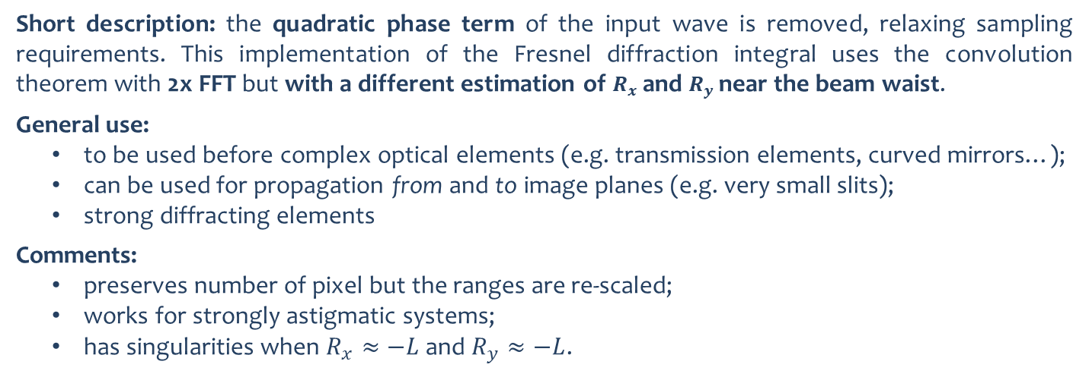
Scalar wave theory – the Fresnel diffraction
SRW propagator #2
$${u_{L}\left(x,y\right)=\exp\left\{\frac{ik}{2}\left[\frac{{\left(x−x_{0}\right)}^{2}}{\left(R_{x}+L\right)}+\frac{{\left(y−y_{0}\right)}^{2}}{\left(R_{y}+L\right)}\right]\right\}⋅ℱ}^{−1}\left\{ℱ\left\{g_{0}\left(x,y\right)\right\}⋅H_{QPT}\left(f_{x}, f_{y}\right)\right\}$$
“Fresnel with analytical treatment of the quadratic (leading) phase terms, yet with different processing near a waist”
Short description: the quadratic phase term of the input wave is removed, relaxing sampling requirements. This implementation of the Fresnel diffraction integral uses the convolution theorem with 2x FFT but with a different estimation of $R_{x}$ and $R_{y}$ near the beam waist.
General use:
to be used before complex optical elements (e.g. transmission elements, curved mirrors…);
can be used for propagation from and to image planes (e.g. very small slits);
strong diffracting elements
Comments:
preserves number of pixel but the ranges are re-scaled;
works for strongly astigmatic systems;
has singularities when $R_{x}≈−L$ and $R_{y}≈−L$.
Chubar and Celestre, Opt. Express 27(20), 28750 (2019)

Slide 20

Scalar wave theory – the Fraunhofer diffraction
SRW propagator #3
Expanding the quadratic terms in the exponential function and collecting terms in the standard Fresnel propagator:
$$u_{L}\left(x,y\right)=\frac{exp\left(jkL\right)}{jλL}exp\left[\frac{jk}{2L}\left(x^{2}{+y}^{2}\right)\right]\iint_{Σ}^{ }{u_{0}(ξ,η)}⋅\exp\left[\frac{jk}{2L}\left(ξ^{2}+η^{2}\right)\right]⋅\exp\left\{−\frac{jk}{L}\left(xξ+yη\right)\right\}ds$$
For sufficiently large propagation distances, i.e. $a^{2}/λL≪1$, we arrive at the Fraunhofer regime:
$$u_{L}\left(x,y\right)=\frac{exp\left(jkL\right)}{jλL}exp\left[\frac{jk}{2L}\left(x^{2}{+y}^{2}\right)\right]\iint_{Σ}^{ }{u_{0}(ξ,η)}⋅\exp\left\{−\frac{jk}{L}\left(xξ+yη\right)\right\}ds$$
which, apart from the multiplicative factors, is the Fourier transform of the input field $u_{0}\left(x,y\right)$ evaluated at frequencies $f_{x}=x/λL$ and $f_{y}=y/λL$:
$$u_{L}\left(x,y\right)∝ℱ\left\{u_{0}\left(x,y\right)\right\}$$
Goodman, Introduction to Fourier Optics, (2017)

Slide 21

Scalar wave theory – the Fraunhofer diffraction
SRW propagator #3
$$u_{L}\left(x,y\right)∝ℱ\left\{u_{0}\left(x,y\right)\right\}$$
“For propagation from a waist over a ~large distance”
Short description: propagator based on the far-field approximation (Fraunhofer) using 1x FFT.
General use:
propagation of a wavefront emerging from a focal plane in both vertical and horizontal directions – from a waist to a ~large distance;
output plane several times larger than the input plane (e.g. scattering experiments);
Comments:
preserves number of pixel but the ranges are re-scaled;
fails for astigmatic systems.

Slide 22
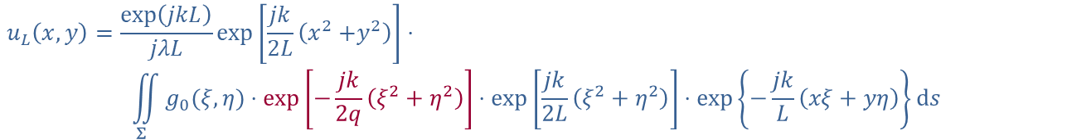

Scalar wave theory – the optical Fourier transform
SRW propagator #4
We consider now a converging wavefront $u_{0}\left(x,y\right)=g_{0}\left(x,y\right)⋅\exp\left[−jk\left(x^{2}+y^{2}\right)/2q\right]$, where $q$ is the distance between wave and focusing plane. We then plug it into the Fresnel integral:
$$u_{L}\left(x,y\right)=\frac{exp\left(jkL\right)}{jλL}exp\left[\frac{jk}{2L}\left(x^{2}{+y}^{2}\right)\right]⋅$$
$$\iint_{Σ}^{ }{g_{0}(ξ,η)}⋅\exp\left[−\frac{jk}{2q}\left(ξ^{2}+η^{2}\right)\right]⋅\exp\left[\frac{jk}{2L}\left(ξ^{2}+η^{2}\right)\right]⋅\exp\left\{−\frac{jk}{L}\left(xξ+yη\right)\right\}ds$$
If the wavefront $u_{0}\left(x,y\right)$ is propagated to the image plane, that is, if $L=q$, the above equation becomes:
$$u_{L}\left(x,y\right)=\frac{exp\left(jkL\right)}{jλL}exp\left[\frac{jk}{2L}\left(x^{2}{+y}^{2}\right)\right]⋅\iint_{Σ}^{ }{g_{0}(ξ,η)}⋅\exp\left\{−\frac{jk}{L}\left(xξ+yη\right)\right\}ds$$
Which is a Fourier transform of the field $g_{0}\left(x,y\right)$ :
$$u_{L}\left(x,y\right)∝ℱ\left\{g_{0}\left(x,y\right)\right\}$$
Goodman, Introduction to Fourier Optics, (2017)

Slide 23

Scalar wave theory – the optical Fourier transform
SRW propagator #4
$$u_{L}\left(x,y\right)∝ℱ\left\{g_{0}\left(x,y\right)\right\}$$
“For propagation over some distance to a waist”
Short description: propagator based on the Fourier transforming property of a lens using 1x FFT.
General use:
propagation of a wavefront to a waist (image plane);
output plane several times smaller than the input plane;
Comments:
preserves number of pixel but the ranges are re-scaled;
fails for astigmatic systems.

Slide 24
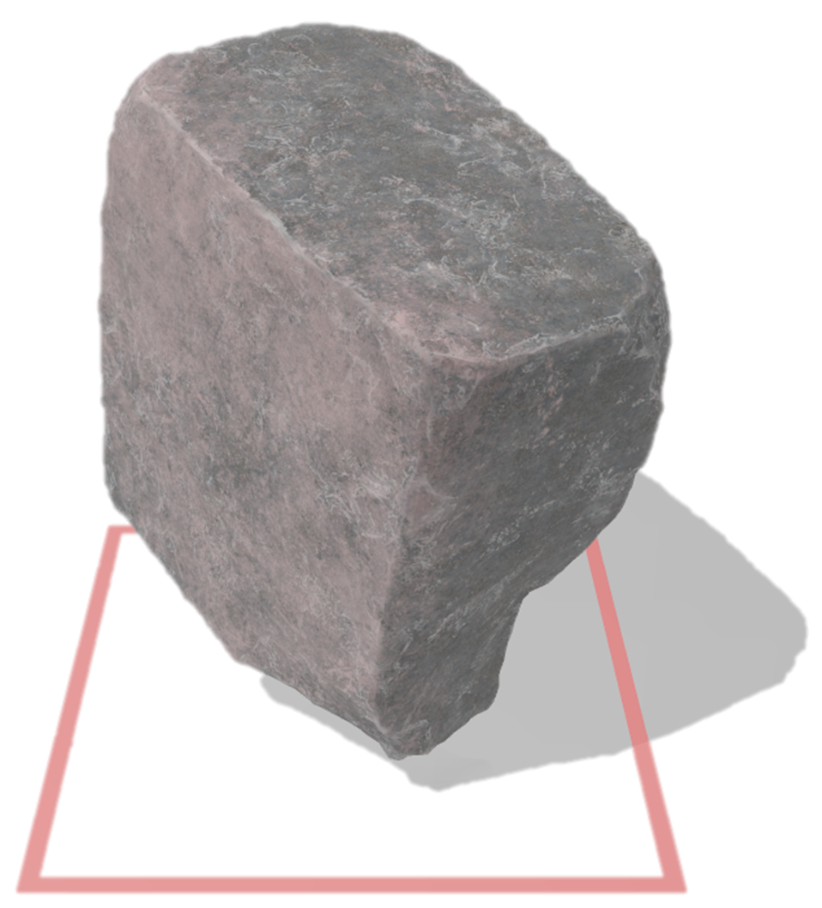
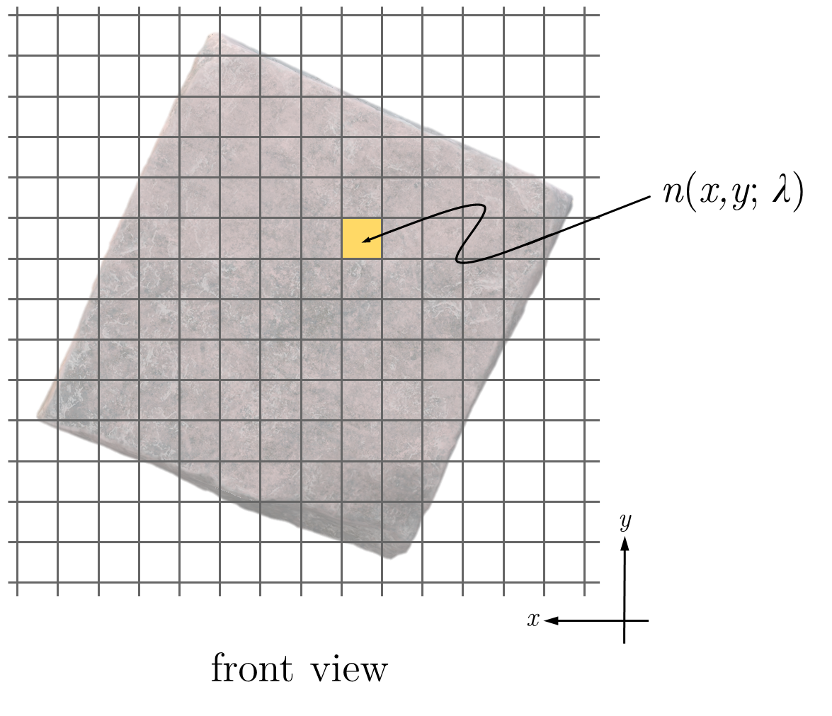
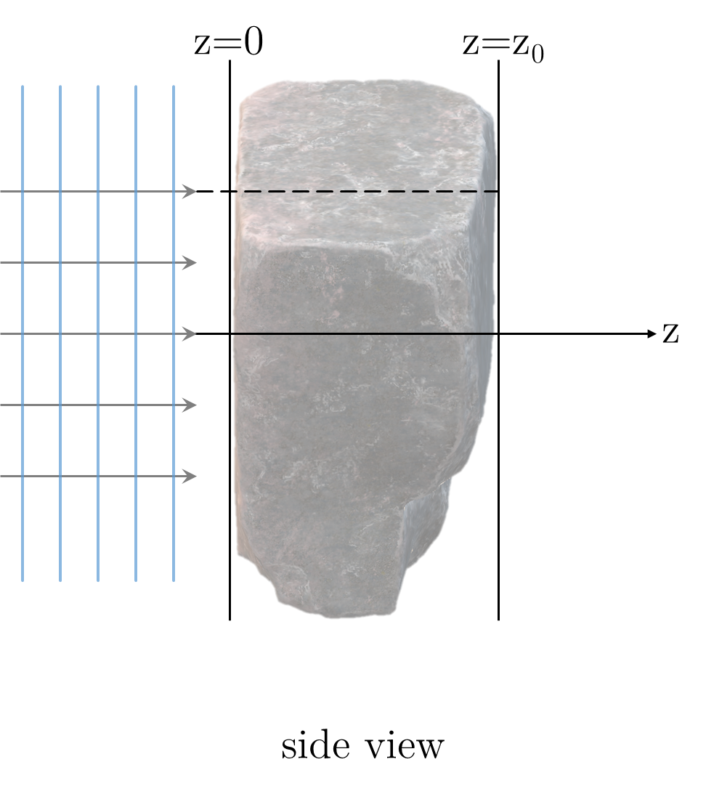
Thin optical elements
Consider the following 3D scattering element:
(a) representation of a weak 3D scattering volume
Paganin, Coherent X-Ray Optics, (2006)

Slide 25
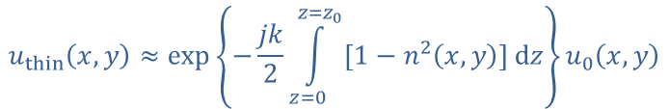

Thin optical elements
If the scatterer is sufficiently weak as to minimally disturb the path that the wave-field would have taken in its absence:
$$u_{thin}\left(x,y\right)≈\exp\left\{−\frac{jk}{2}\int_{z=0 }^{z=z_{0}}{\left[1−n^{2}\left(x,y\right)\right] dz}\right\}u_{0}\left(x,y\right)$$
Since $n=1−δ+j⋅β$ and because $1−δ≈1$ we can approximate: $1−n^{2}≈2\left(δ+j⋅β \right)$:
$$u_{T}\left(x,y\right)≈\exp\left\{−jk\left[δ\left(x,y\right)+j⋅β\left(x,y\right)\right]Δ_{z}\left(x,y\right)\right\}u_{0}\left(x,y\right)$$
The complex transmission operator in projection approximation can be written as:
$T\left[Δ_{z}\left(x,y\right)\right]= exp\left\{−jk\left[δ\left(x,y\right)+j⋅β\left(x,y\right)\right]Δ_{z}\left(x,y\right)\right\}=\sqrt{T_{BL}\left(Δ_{z}\right)}⋅\exp\left[jφ\left(Δ_{z}\right)\right]$
Finally:
$$u_{thin}\left(x,y\right)=T\left[Δ_{z}\left(x,y\right)\right]⋅u_{0}\left(x,y\right)$$
Paganin, Coherent X-Ray Optics, (2006)

Slide 26
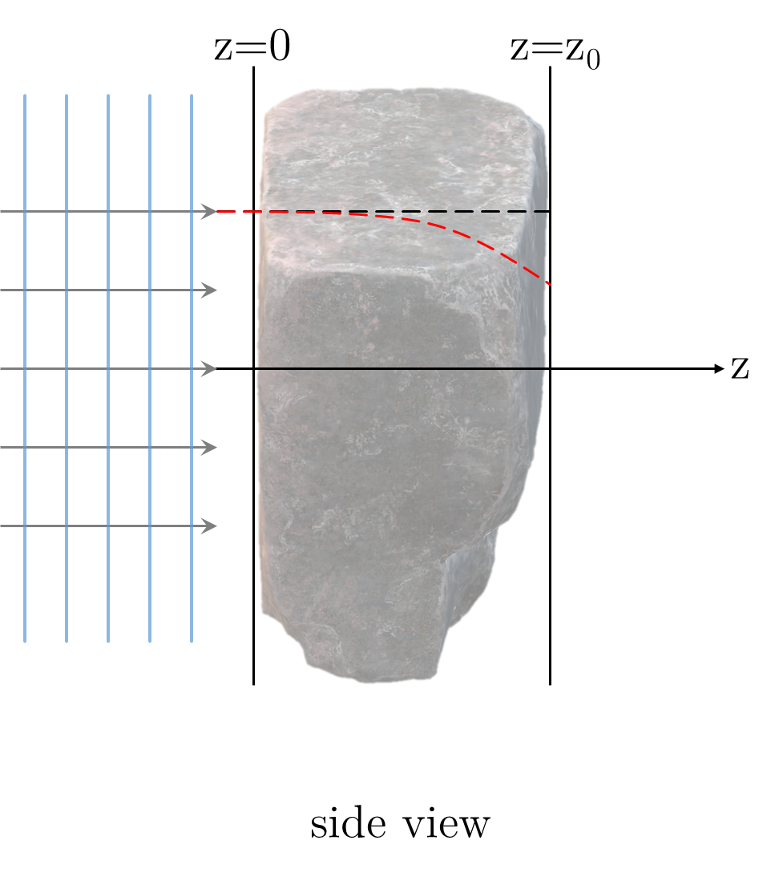
Thick optical elements
We consider now the following 3D scattering element:
(a) representation of thick scattering volume
Paganin, Coherent X-Ray Optics, (2006)

Slide 27
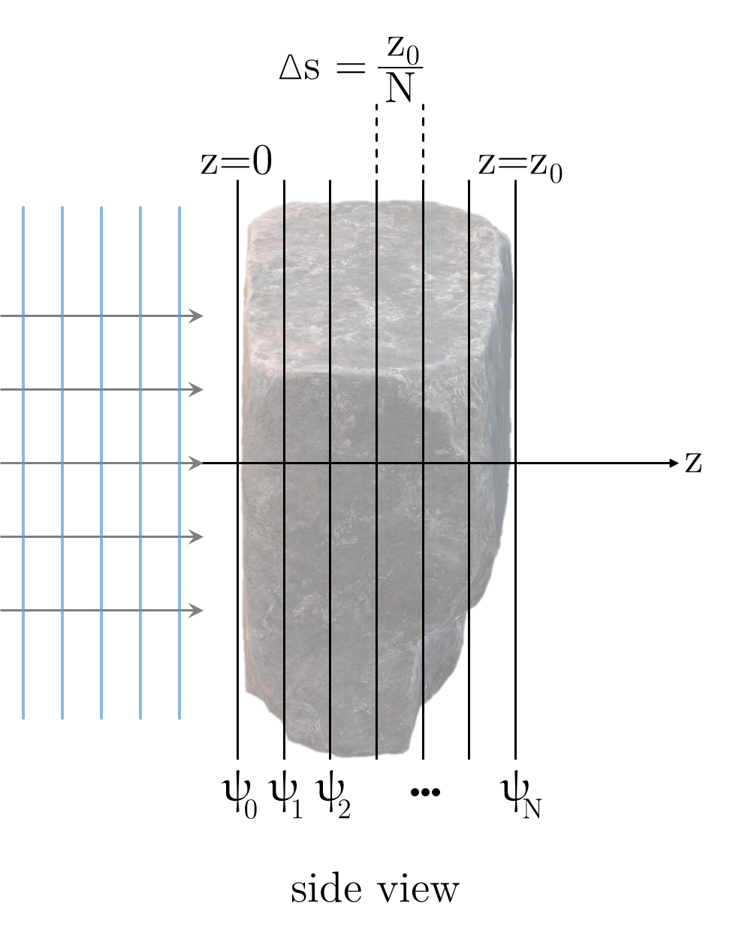
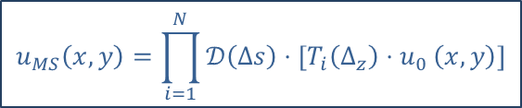
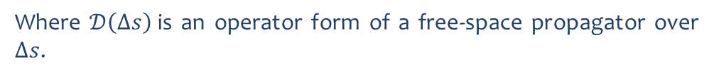
Thick optical elements
A thick optical element can be sliced into a number N of parallel slabs until the projection approximation holds between two adjacent slices separated by vacuum.
The wave propagation through this thick element is given by:
$$u_{MS}\left(x,y\right)=\prod_{i=1}^{N}{𝒟\left(Δs\right)⋅\left[T_{i}\left(Δ_{z}\right){⋅u}_{0}\left(x,y\right)\right]}$$
Where $𝒟\left(Δs\right)$is an operator form of a free-space propagator over $Δs$.
See also:
- Li, Wojcik and Jacobsen, Opt. Express 25(3), 1831 (2017)
- Munro, J. Opt. Soc. Am. A 36(7), 1197 (2019)
(a) representation of a tick scattering volume as a series of thin elements (multi-slicing)
Paganin, Coherent X-Ray Optics, (2006)

Slide 28
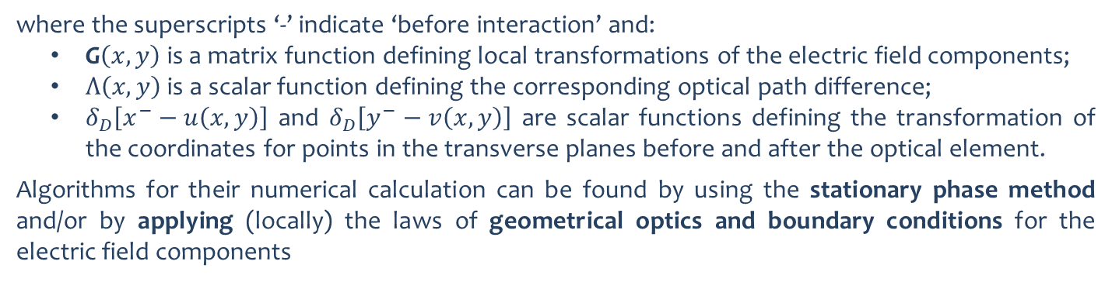
Thick optical elements
Alternatively, a thick optical element (e.g. grazing incidence mirrors) can be represented by:
$$u_{thick}\left(x,y,x^{−},y^{−}\right)$$
$$≈G\left(x,y\right)⋅\exp\left[jk⋅Λ\left(x,y\right)\right]δ_{D}\left[x^{−}−u\left(x,y\right)\right]δ_{D}\left[y^{−}−v\left(x,y\right)\right]⋅u_{0}\left(x^{−},y^{−}\right)$$
where the superscripts ‘-’ indicate ‘before interaction’ and:
G$\left(x,y\right)$ is a matrix function defining local transformations of the electric field components;
$Λ\left(x,y\right)$ is a scalar function defining the corresponding optical path difference;
$δ_{D}\left[x^{−}−u\left(x,y\right)\right]$ and $δ_{D}\left[y^{−}−v\left(x,y\right)\right]$ are scalar functions defining the transformation of the coordinates for points in the transverse planes before and after the optical element.
Algorithms for their numerical calculation can be found by using the stationary phase method and/or by applying (locally) the laws of geometrical optics and boundary conditions for the electric field components
See also:
- Zachariasen, Theory of X-Ray Diffraction in Crystals (1945)
- Sutter, Chubar and Suvorov, Proc. SPIE 9202(3), 1831 (2014)
- Sutter et al, Proc. SPIE 11493(0V), 1831 (2020)
Canestrari, Chubar and Reininger, J Synchrotron Rad 21(5), 1110–1121 (2014)

Slide 29
Where to learn more?
SRW:
Chubar, "Precise computation of electron-beam radiation in nonuniform magnetic fields as a tool for beam diagnostics," Review of Scientific Instruments 66(2), 1872–1874 (1995)
Chubar and Elleaume, "Accurate And Efficient Computation Of Synchrotron Radiation In The Near Field Region", Proc. EPAC98 1177-1179 (1998)
Chubar et al, "Development of partially-coherent wavefront propagation simulation methods for 3rd and 4th generation synchrotron radiation sources”, Proc. SPIE 8141, (2011)
Laundy et al, "Partial coherence and imperfect optics at a synchrotron radiation source modeled by wavefront propagation”, Proc. SPIE 9209, (2014)
Chubar et al, ""Main functions, recent updates, and applications of Synchrotron Radiation Workshop code”, Proc. SPIE 10388, (2017)
Li and Chubar, "Memory and CPU efficient coherent mode decomposition of partially coherent synchrotron radiation with subtraction of common quadratic phase terms," Opt. Express 30(4), 5896 (2022)
Chubar et al, "Physical optics simulations for synchrotron radiation sources," J. Opt. Soc. Am. A 39(12), (2022)
Physical optics:
Goodman, Introduction to Fourier Optics, (2017)
Paganin, Coherent X-Ray Optics, (2006)
Southwell, "Validity of the Fresnel approximation in the near field," J. Opt. Soc. Am. 71(1), 7 (1981)
Rees, "The validity of the Fresnel approximation," Eur. J. Phys. 8(1), 44–48 (1987)
Kelly, "Numerical calculation of the Fresnel transform," J. Opt. Soc. Am. A 31(4), 755 (2014)

Slide 30
Acknowledgment
The author is grateful to Oleg Chubar, Brookhaven National Lab, for all the fruitful discussions regarding accurate optical simulations, physical optics and SRW. The author is also thankful to everyone who contributed to the SRW project in any capacity.

Slide 31
Thank you!

